Slide 1
SHIKSHA EKIKARAN
INTEGRATION OF SCHOOL, HIGHER AND TECHNICAL EDUCATION IN INDIA

Slide 2
Functional Requirements
Integration of the education system, in the sense: Knowing what is taught at each level so that the next or previous level can know what to change in their education system and policy.
Helps to understand in which areas education is varied, like how education in Telangana might not be the same as in Tamil Nadu. So if a student shifts from one place to the other, they shouldn't feel lost.
Our service should help all educational levels create a curriculum in such a way that it's easy for students at every level.
Tackling problems such as specially-abled, gender wise and teacher-student.

Slide 3
FOCUS
Focus is more on the educational policies, how it is taught and what is taught
Access is given more to Educational Heads, and Governing Authorities
Educational Heads to check what is to be taught and what changes to be made
Governing Authorities so that they know what new policies are supposed to be implemented for more growth and development

Slide 4
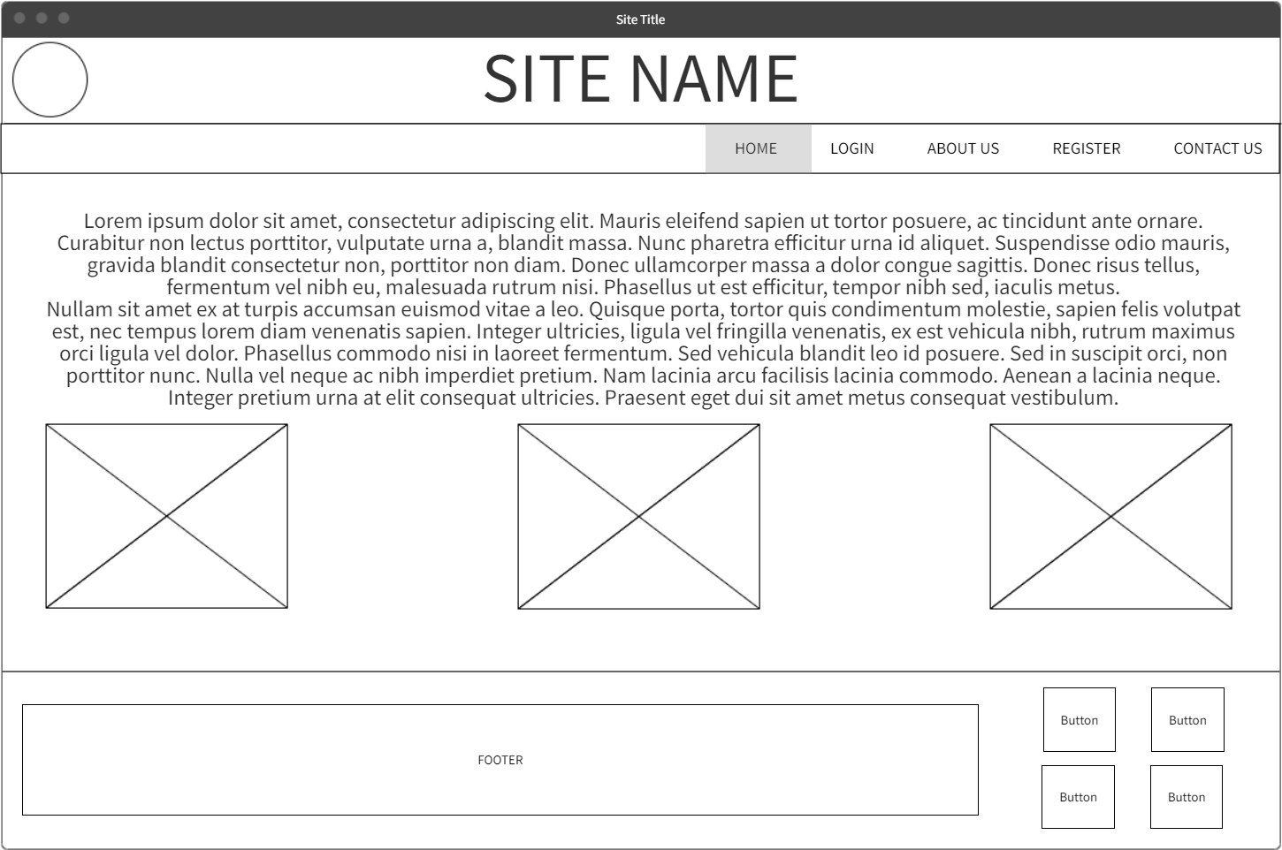

Slide 5
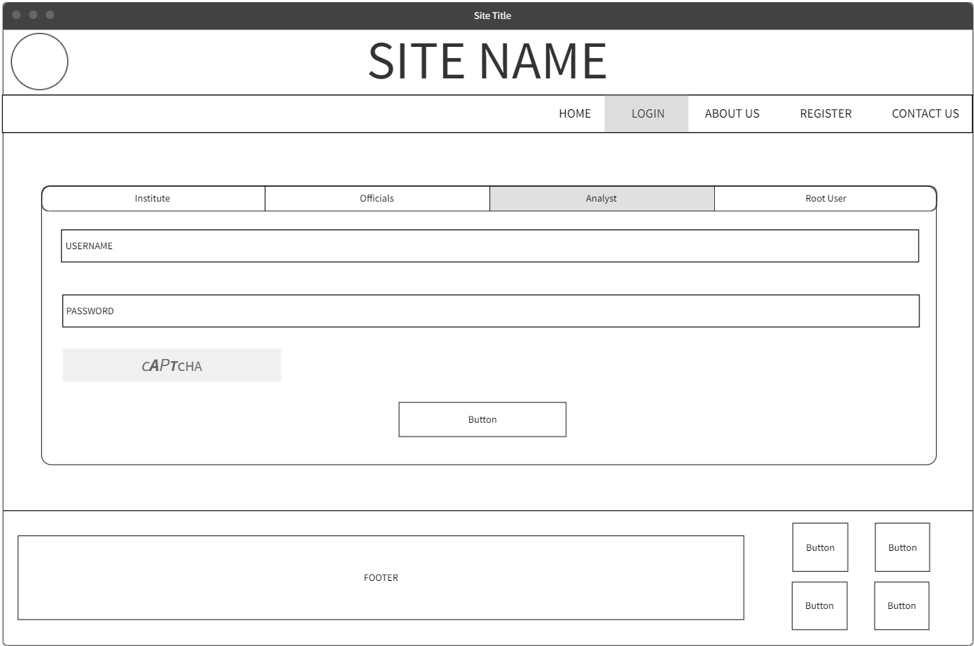

Slide 6
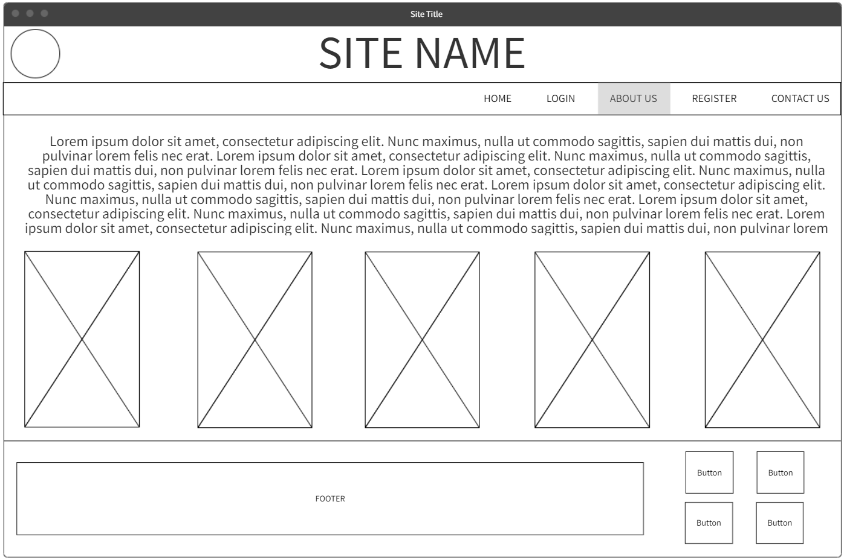

Slide 7
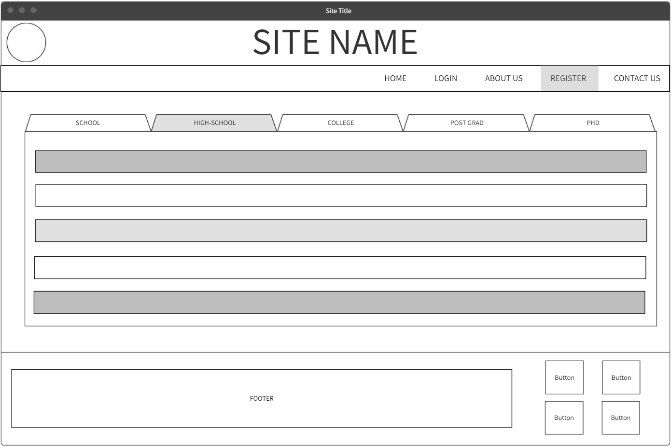

Slide 8
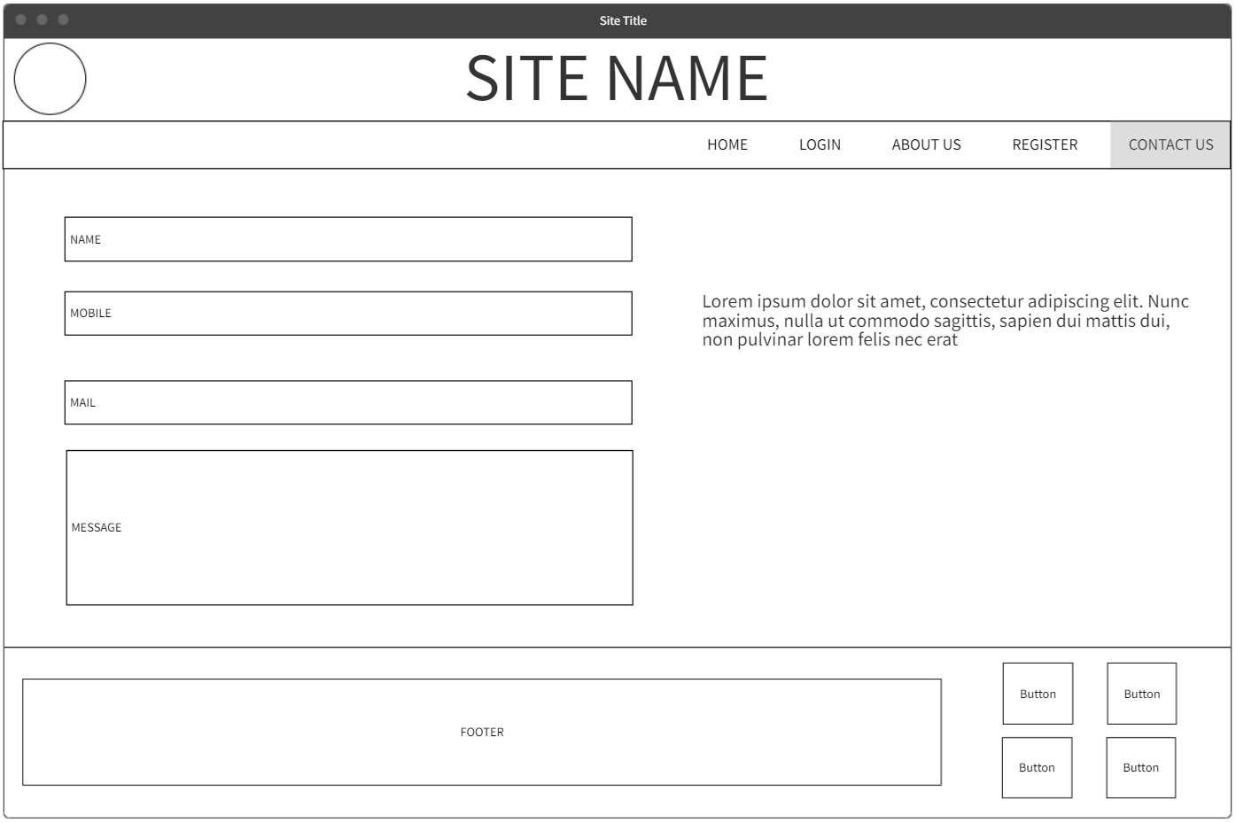

Slide 9
END RESULT
Data on all the features of what is taught and the stats
Guidance on what is taught to help the other levels

